Slide 1
CEIS 150 Project: Python Stock Tracking Sheet
Tyler Brainer

Slide 2
Introduction
I designed a program in python that had a multifunction menu. You can add, delete, and list stocks as well as add daily data, and show a chart.

Slide 3
Class Diagrams, coding, and unit testing
First I Created a Diagram to show what variables need to apply to each stock. I then began coding each Class and definition for parameters. I finished with a Unit test to make sure calculations followed as expected.

Slide 4
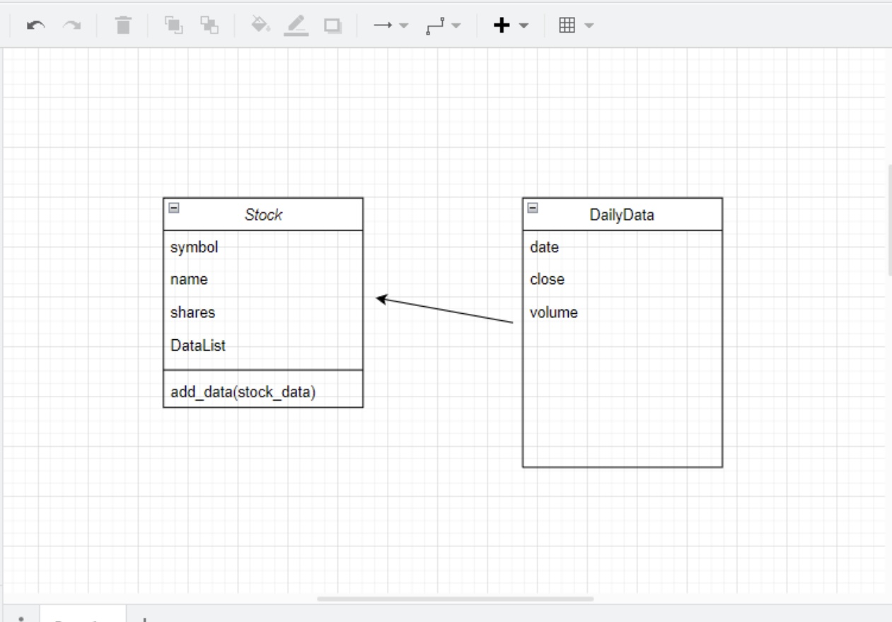
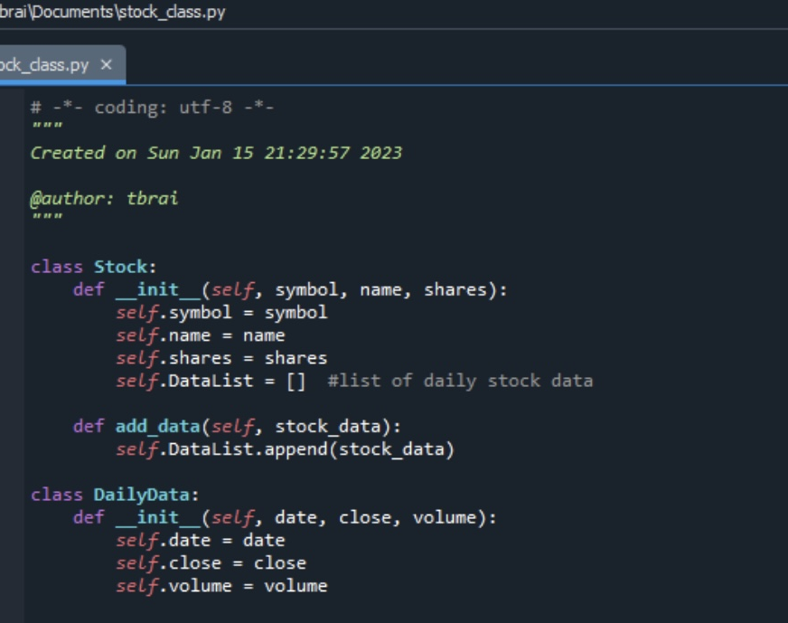
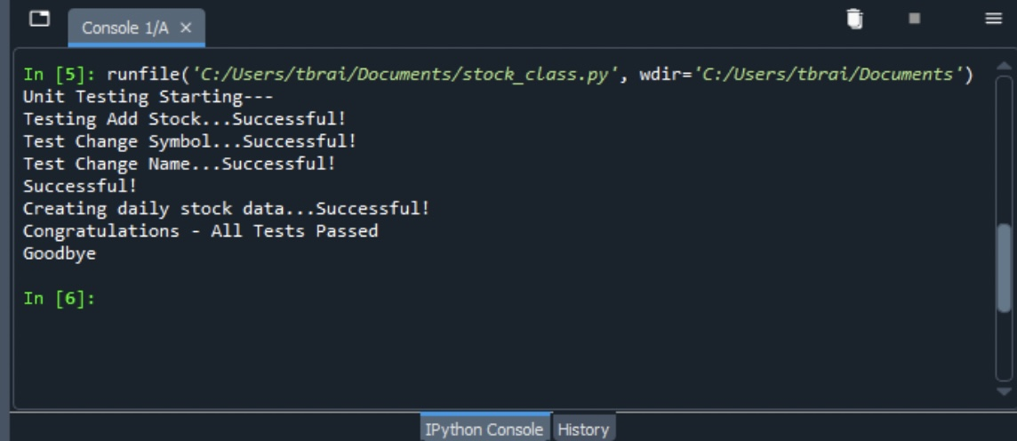

Slide 5
Adding stocks and data, and Listing
I coded the functions for adding a stock and listing a stock. I tested them listing a few stocks and entered daily data for one of them.

Slide 6
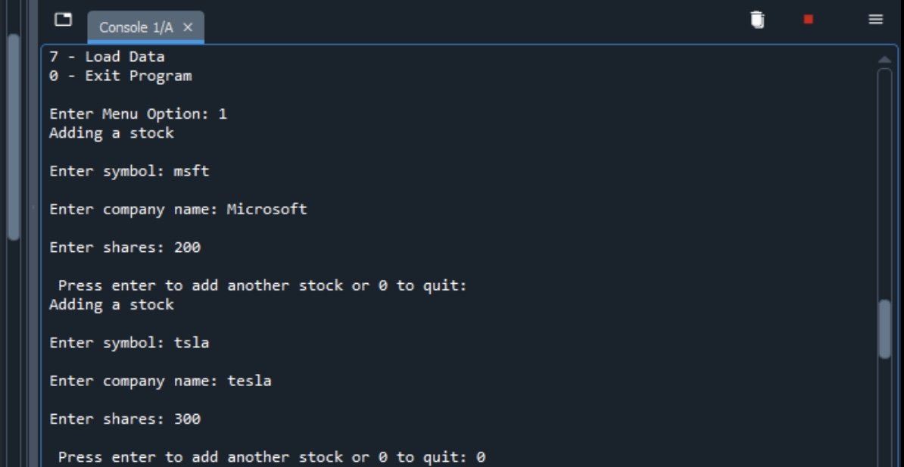
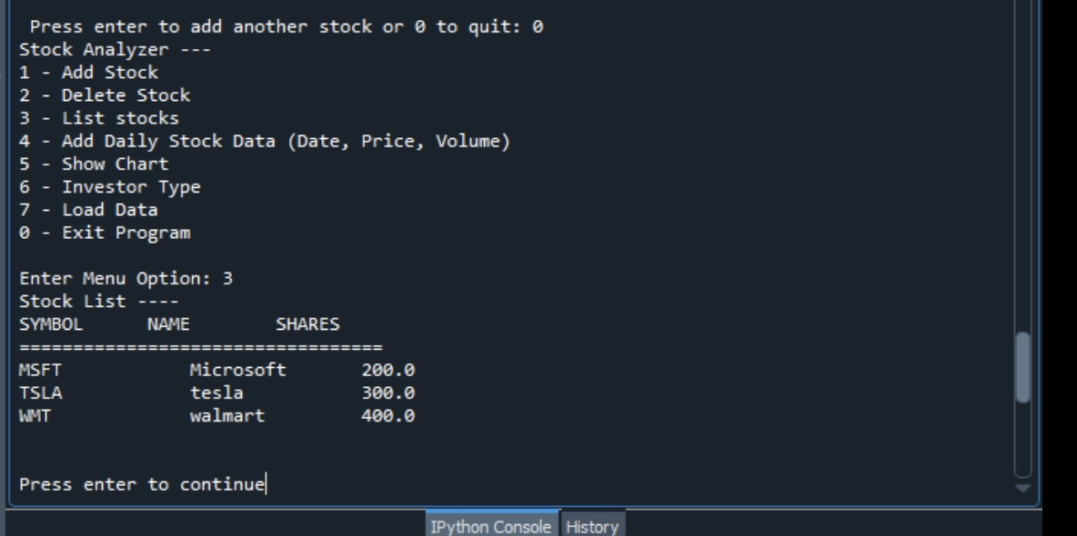
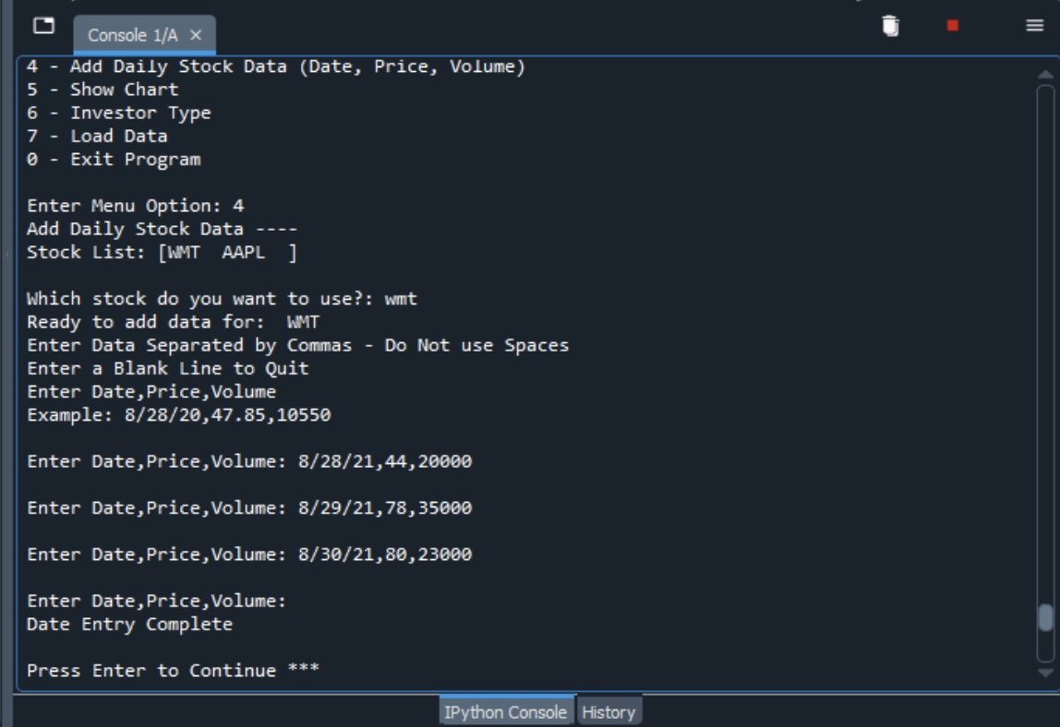

Slide 7
Inheritance with Classes
I created several more classes in a separate file. These classes inherit the properties which means I can use the properties from the main class for the other ones. I followed up with a Unit test.

Slide 8
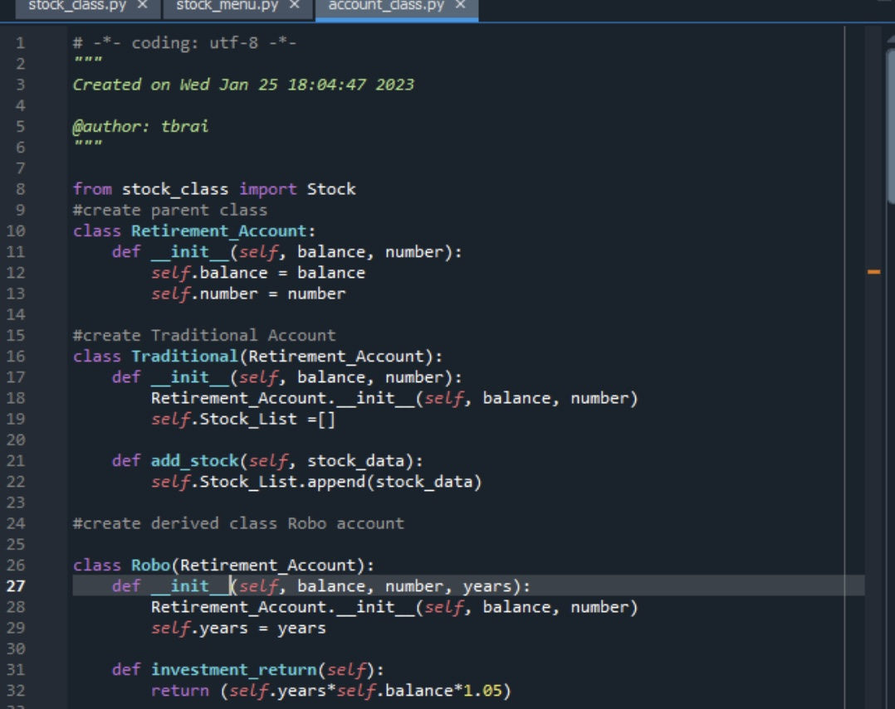
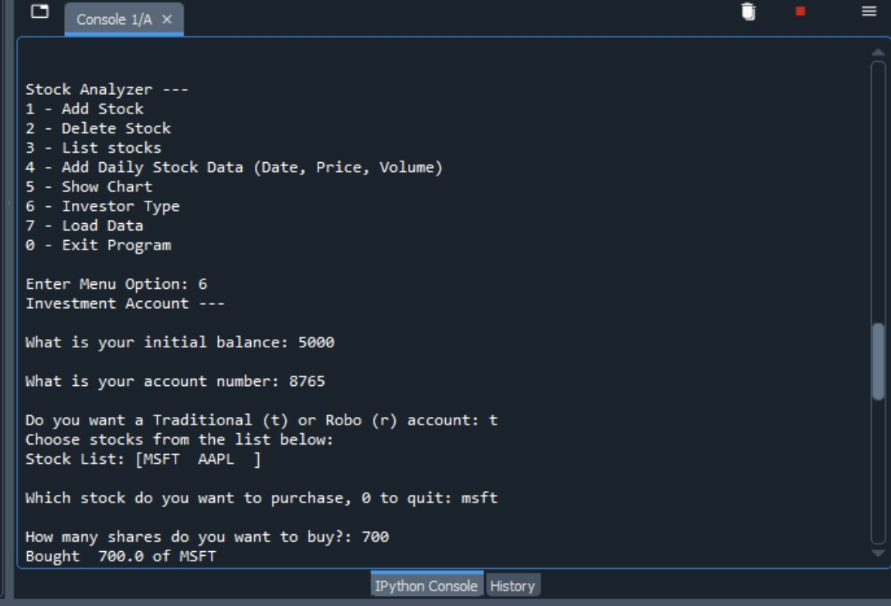
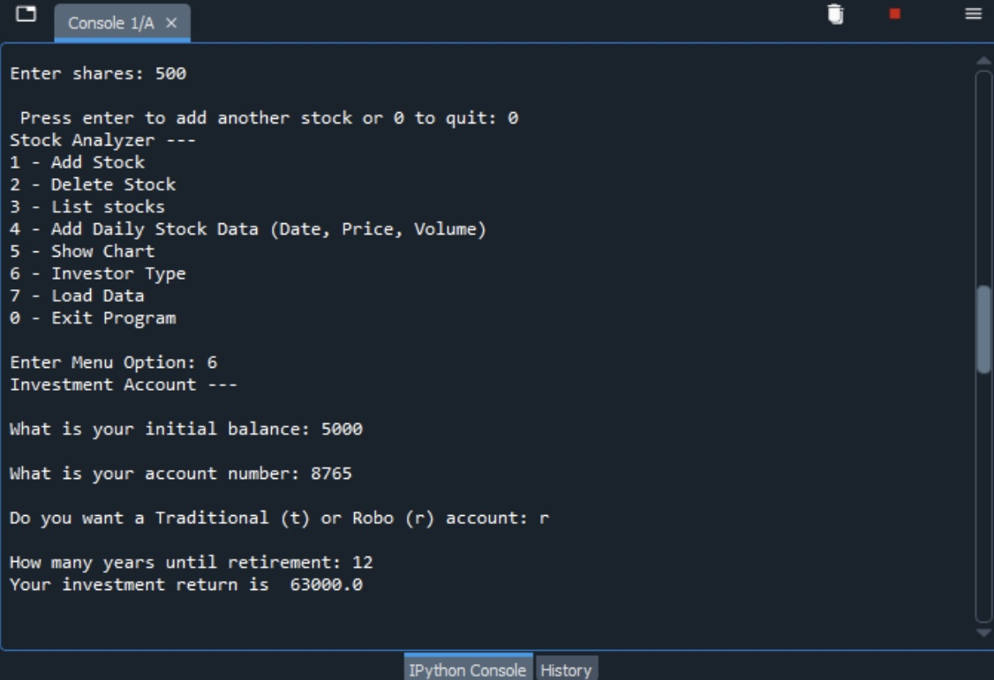
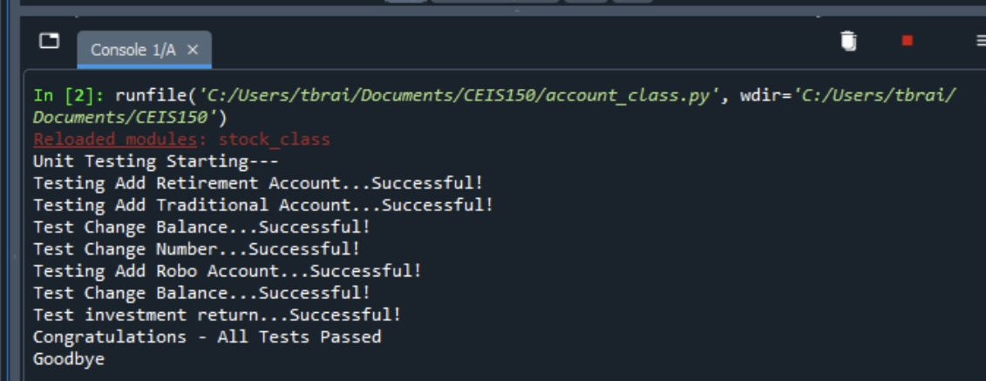

Slide 9
Creating a Chart
I used a python library for plotting on a graph to take information entered for the daily data and display it in a chart

Slide 10
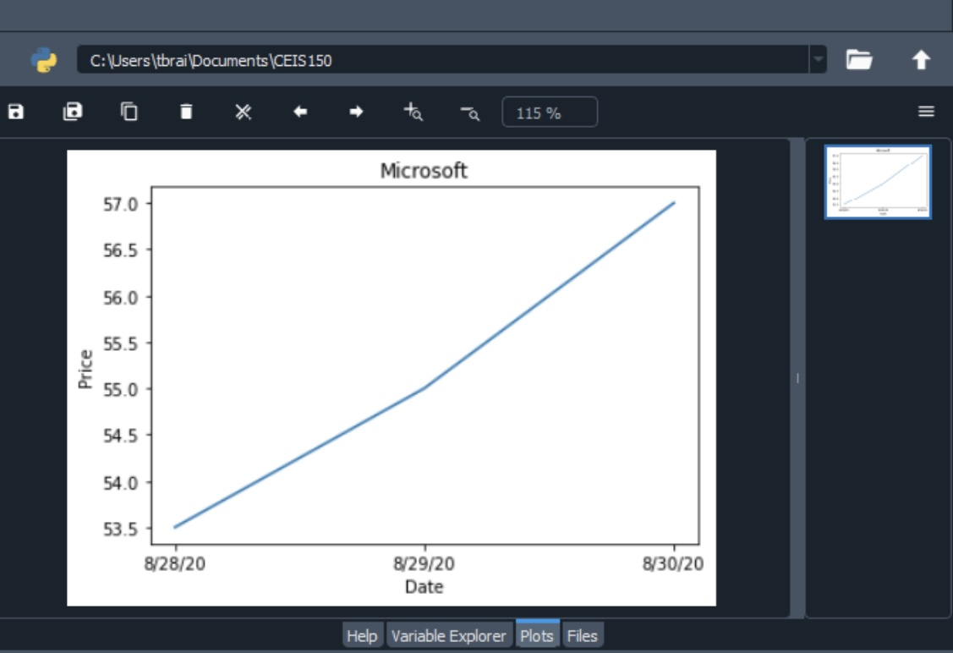

Slide 11
Loading data
I used data from a CSV file to display historical history of a stock to the user.

Slide 12
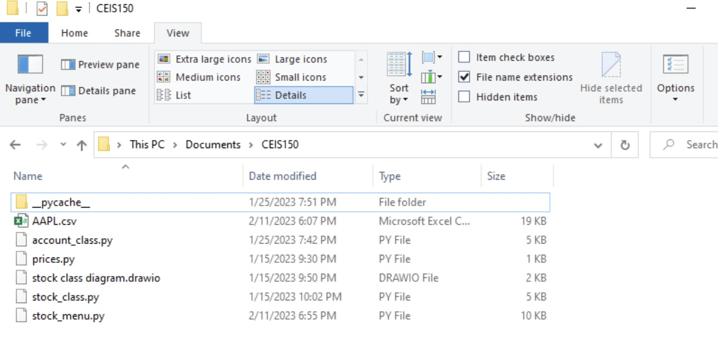
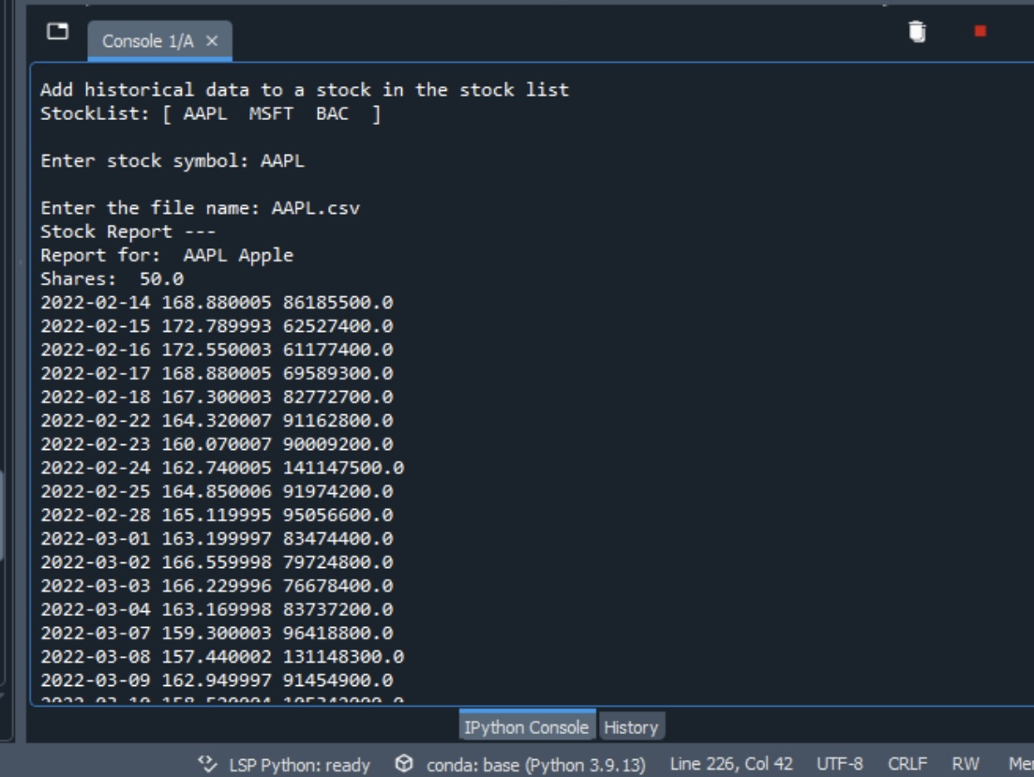
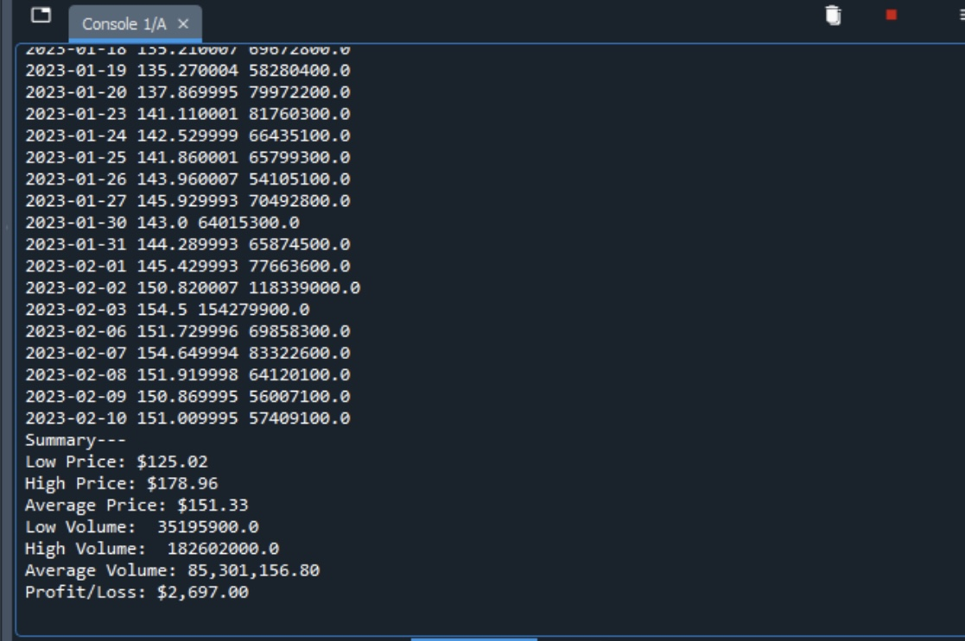

Slide 13
Creating A GUI
I created a GUI for my program to be better suited for the end user. This included adding and deleting a stock, importing web data (CSV), and history and report tab

Slide 14
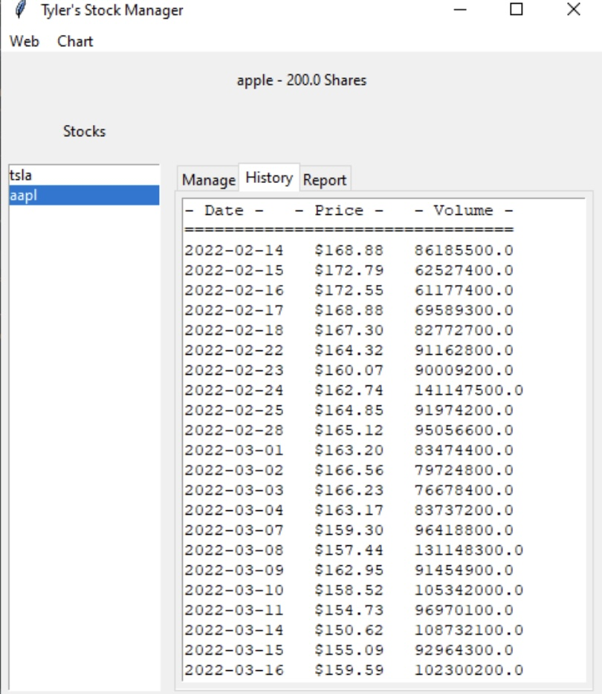
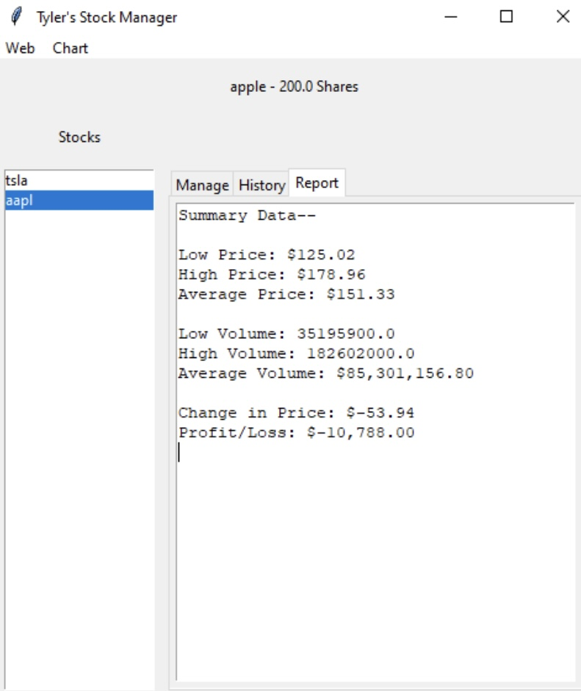
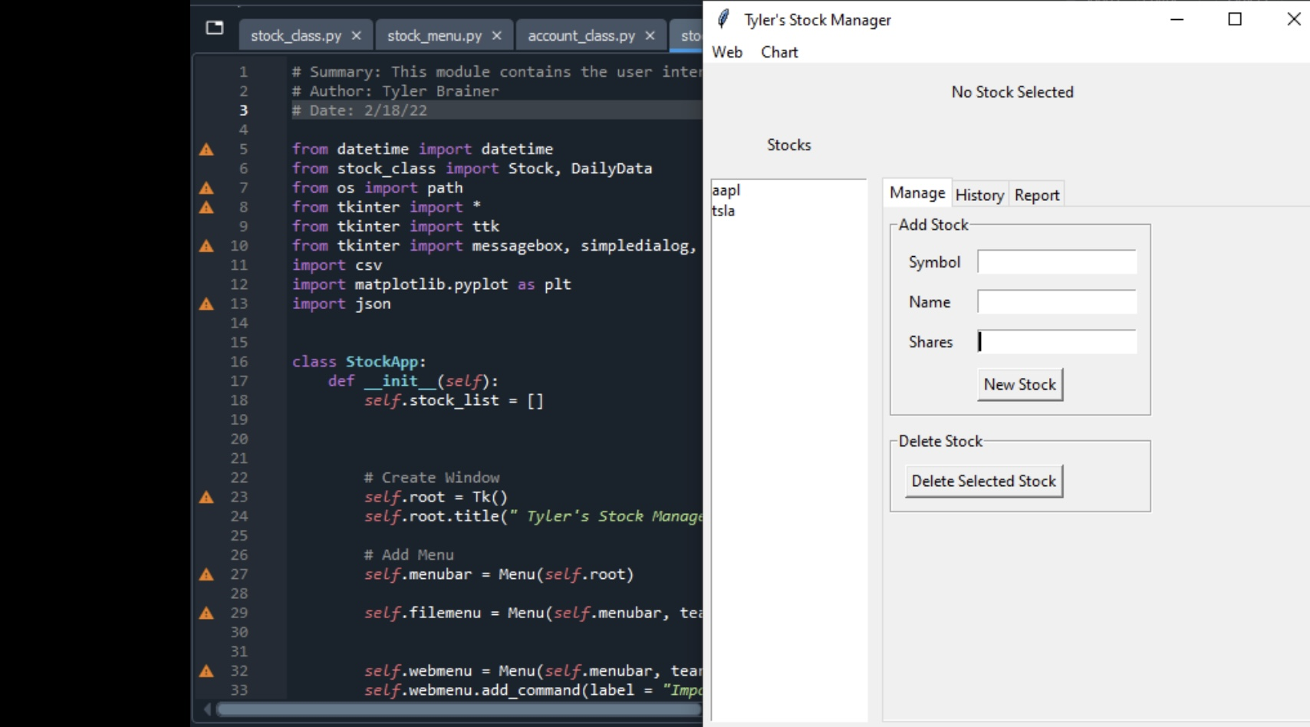

Slide 15
Career Skills Developed
Coding using python
Object oriented programming
Using python libraries
Web Scrapping in programming

Slide 16
Conclusion
In this project I learned how to use object oriented programming to code more efficiently. I have a better understanding of how to use data from the web to implement in the program as well as programming syntax. I enjoyed programming each step and seeing the final project come together.

